Slide 1

Group-1
Notes:
ID=d924773e-9a16-4d6d-9803-8cb819e99682 Recipe=text_billboard Type=TextOnly Variant=0 FamilyID=AccentBoxWalbaum_Zero

Slide 2
RLL-Group1
Name | Employee ID
Quamar Iqbal | 2582839
Sangeetha V | 2584034
Poojari Sreenath | 2583297
Bathala Nagamani | 2580281
Mudadla Srikanth | 2583086
P Rachana | 2583398
Pulicheri Sony | 2583872

Slide 3

Agenda
Introduction
Objectives
Technologies Used
Modules
Test Scenario
Screenshots
Conclusion

Slide 4


Introduction
FirstCry is an e-commerce platform and mobile application that specializes in providing products for babies, toddlers, and mothers. It offers a wide range of products including baby clothing, diapers, toys, feeding accessories, maternity wear, nursery furniture, and more. The app provides a convenient shopping experience for parents, allowing them to browse and purchase essential items for their children from the comfort of their homes, also provides features like product reviews, shortlist, and personalized recommendations to enhance the shopping experience.

Slide 5
What is the need of Automation Testing?
Testing for the FirstCry website is crucial to ensure a smooth and user-friendly experience for customers.
Firstly, testing helps identify and fix any technical issues or bugs that may arise during website usage, such as broken links, loading errors, or compatibility issues across different browsers and devices.
Additionally, it ensures that all features and functionalities, such as search filters, sorting options, and payment gateways, work seamlessly, providing a hassle-free shopping experience.
Testing also helps evaluate the website's performance, including speed and responsiveness, optimizing it for efficient navigation.
Overall, thorough testing is essential to maintain the website's reliability, functionality, and overall customer satisfaction.

Slide 6
Technologies Used
TestNG & Junit
Selenium WebDriver
Cucumber
Jira
Data Driven Testing
POM framework
Extent reports & Log4j
TestNG Listeners
IRetry Listener

Slide 7
Selenium WebDriver:
Selenium WebDriver is an automation tool that allows users to interact with web browsers programmatically.
WebDriver facilitates actions such as clicking buttons, entering text, and navigating through web pages by directly communicating with the browser.
It supports various browsers and provides a rich set of APIs for interacting with web elements.
With WebDriver, users can write automated test scripts using their preferred programming language, enhancing testing productivity and enabling robust web application testing.

Slide 8
Usage of Selenium WebDriver:
Selenium WebDriver is primarily used for automating testing tasks in web applications. Some common use cases of Selenium WebDriver include:
Writing and executing automated test scripts to validate the functionality of web applications.
Automating repetitive tasks such as form submissions, data entry, and navigation across web pages.
Performing cross-browser testing to ensure consistent functionality across different web browsers.
Integrating with testing frameworks like TestNG or JUnit to manage test suites, generate reports, and handle dependencies.
Implementing data-driven testing by parameterizing test scripts to execute with multiple sets of data.

Slide 9
Benefits of using Selenium WebDriver:
Cross-Browser Compatibility
Language Support
Platform Independence
Integration with Testing Frameworks
Enhanced Test Automation
Cost-Effective Testing

Slide 10
POM Framework
The POM is a design pattern that separates the page elements (locators, buttons, text fields, etc.) from the test scripts.
It promotes code reusability, maintainability, and readability. Each web page of the application under test has a corresponding page object class.
Page object classes encapsulate the functionalities of the web page, including methods for interacting with elements and verifying their state.

Slide 11
Implementation of POM framework
1.Create Page Object Classes:
Develop a separate class for each web page of the application under test.
Within each class, define
→Web element locators (using techniques like id, name, css selector,etc.)
→Methods to interact with elements (click, type text, etc.)
→Methods to verify element state (is displayed, text content, etc.)
2. Utilize Page Object Classes in Test Scripts:
Create test scripts that:
→Instantiate page object classes for relevant web pages.
→Call methods from page object classes to interact with elements.
→Verify expected behaviour using assertions.

Slide 12
Advantages of the POM Framework
Increased Code Reusability: Page object classes can be reused by multiple test scripts, reducing code duplication.
Improved Maintainability: Changes to the UI require modifying only the relevant page object class, not multiple test scripts.
Enhanced Readability: Separating page elements from test logic improves test script clarity and understanding.
Efficient Debugging: Isolating element interactions within page objects simplifies debugging efforts.

Slide 13
Cucumber
Cucumber is a popular open-source tool used for Behavior-Driven Development (BDD) in software testing.
It allows tests to be written in natural language, making them easier to read and understand.
Cucumber uses a syntax called “Gherkin”, which employs plain text with keywords such as Given, When, Then, And, and But to outline test scenarios.
It promotes collaboration between technical and non-technical team members in software development. Cucumber works seamlessly with well-known software platforms like Selenium and Ruby.

Slide 14
Use Case:
Feature Files: Write scenarios and steps in plain text files (.feature) to test different parts of the application.
Scenario Outline: Use to create data-driven tests with varying input combinations.
Background: Define preconditions for all scenarios in the file for consistency.
Step Definitions: Map Gherkin steps to code for actions and verifications.
Integration with Page Objects Model: Interact with Page Objects for actions on the Firstcry website's web elements.

Slide 15
Advantages:
Easy-to-Understand Language: Cucumber uses a language that's easy for both techies and non-techies to grasp.
Step Reusability: Steps written in Cucumber can be recycled, cutting down repetition and simplifying test maintenance.
Clear Test Reports: Cucumber generates straightforward reports, making it simple to spot which scenarios passed and which didn’t.
Data Tables and Scenario Outlines: With Cucumber, you can include data tables and scenario outlines, allowing for flexible testing with different data sets.
Parallel Execution Support: Cucumber enables running tests concurrently, helping teams to speed up overall test execution.

Slide 16
Data Driven Testing
Data Driven framework is used to drive test cases and suites from an external data feed. The data feed can be data sheets like xls, xlsx, and csv files.
A Data Driven Framework in Selenium is a technique of separating the “data set” from the actual “test case” (code).
Since the test case is separated from the data set, one can easily modify the test case of a particular functionality without making changes to the code.
For example, if one has to modify the code for login functionality, they can modify just the login functionality instead of having to modify any other feature dependent on the same code.
One can easily increase the number of test parameters by adding more username and password fields to the excel file (or other sources).

Slide 17
Implementation:
list of different Java Interfaces and classes in POI for reading XLS and XLSX file-
Workbook: XSSFWorkbook and HSSFWorkbook classes implement this interface.
XSSFWorkbook: Is a class representation of XLSX file.
HSSFWorkbook: Is a class representation of XLS file.
Sheet: XSSFSheet and HSSFSheet classes implement this interface.
XSSFSheet: Is a class representing a sheet in an XLSX file.
HSSFSheet: Is a class representing a sheet in an XLS file.
Row: XSSFRow and HSSFRow classes implement this interface.
XSSFRow: Is a class representing a row in the sheet of XLSX file.
HSSFRow: Is a class representing a row in the sheet of XLS file.
Cell: XSSFCell and HSSFCell classes implement this interface.
XSSFCell: Is a class representing a cell in a row of XLSX file.
HSSFCell: Is a class representing a cell in a row of XLS file.

Slide 18
Advantage:
Allows testing of the application with multiple sets of data values during regression testing.
Separates the test case data from the executable test script.
Allows reusing of Actions and Functions in different tests and generates test data automatically. This is helpful when large volumes of random test data are necessary.
Reusable Test Cases: When you separate test data from test logic, your test cases become more reusable. You can execute the same test script with different data, reducing redundancy and maintenance effort.

Slide 19
TestNG (Test Next Generation)
It is a testing framework inspired by JUnit and NUnit, designed for simplifying test configuration and parallel execution.
Developed by Cedric Beust, TestNG offers powerful features for testing Java applications and provides a more flexible and easily configurable testing environment.
The design goal of TestNG is to cover a wider range of test categories: unit, functional, end-to-end, integration, etc.,
TestNG supports parallel test execution, test configuration through annotations, data-driven testing, and comprehensive test reporting.

Slide 20
TestNG Annotations
i)@BeforeSuite@BeforeTest@BeforeGroup@BeforeClass @BeforeMethod
ii) @AfterSuite @AfterTest @AfterGroup @AfterClass @AfterMethod
iii) @Test @DataProvider @Factory @Listeners
Assertions:
assertEquals, assertNotEquals
assertTrue, assertFalse
assertNull, assertNotNull
assertSame, assertNotSame
fail

Slide 21
2 Types of Asserts:
i)Hard assert: Throws an Assert Exception immediately when an assert fails and test suite continues with next @Test method
ii) Soft assert: Does not throws an Assert Exception immediately when an assert fails and collects errors during @Test method

Slide 22
JUnit
JUnit is part of unit testing frameworks family collectively known as xUnit and now become the standard tool for Test-Driven Development in Java.
JUnit test, generators now part of many Java IDEs (Eclipse, BlueJ, Jbuilder, DrJava etc).
JUnit provides Annotation to identify the test methods and utility methods to assert expected result.
JUnit has Test runners for running tests.
JUnit Framework can be easily integrated with either of the followings: Eclipse, Ant, Maven

Slide 23
Can test JUnit by using Test Case & Test Suit.
i) Test Case: A Test Case is a java class which is used to test a single class.
ii) Test Suite: A Test Suit is a java class which contains many test cases or java classes to test together in a single run.
Benefits:
Simple framework for writing automated, self-verifying tests in Java
Support for test assertions
Test suite development
Immediate test reporting

Slide 24
Need of JUnit:
JUnit tests allow you to write code faster while increasing quality.
JUnit is elegantly simple. It is less complex & takes less time.
JUnit tests can be run automatically and they check their own results and provide immediate feedback. There's no need to manually comb through a report of test results.
JUnit tests can be organized into test suites containing test cases and even other test suites.
Writing JUnit tests is inexpensive.

Slide 25
Extent Reports
Extent Reports is a Java-based reporting library that facilitates the creation of comprehensive and interactive HTML reports for test automation.
It is commonly used in conjunction with testing frameworks like Selenium and Cucumber to enhance the presentation and analysis of test results.
Benefits of using extent report
Extent Reports generate visually appealing HTML reports that include charts, graphs, and interactive dashboards.
The reports provide a detailed summary of test executions, including the number of passed, failed, and skipped tests.

Slide 26
Extent Reports allow the inclusion of screenshots for failed test steps, providing visual evidence of the issues.
Extent Reports can be easily integrated with popular test automation frameworks like TestNG, JUnit, Selenium, and Cucumber.
Users can customize the appearance and structure of Extent Reports to meet project-specific requirements.
Extent Reports contain two major, frequently used classes:
ExtentReports class
ExtentTest class
Both classes can be used with the following built-in methods:
startTest: Executes preconditions of a test case
endTest: Executes postconditions of a test case
Log: Logs the status of each test step onto the HTML report being generated
Flush: Erases any previous data on a relevant report and creates a whole new report

Slide 27
A Test Status can be indicated by the following values:
PASS
FAIL
SKIP
INFO
SCREENSHOT FOR TEST FAILURE:
Create a class. Implement TestNG ITestListener.
Call the method onTestFailure.
In the extent test on fail call screenshot class and use them in: Test level (OR) Log level
Get Failed test a message and status and take a screenshot.

Slide 28
Log4J
What is Log4j?
Log4j is a robust and versatile logging framework for Java applications.
It facilitates the generation of log messages from various parts of your code.

Slide 29
Key Features:
Configurability: Log4j allows configuration through XML, JSON, or properties files, providing flexibility in adjusting logging behaviour without code modifications.
Logging Levels: Supports different logging levels (TRACE, DEBUG, INFO, WARN, ERROR, FATAL) to help categorize and filter log messages based on severity.
Appender System: Utilizes an appender system to define output destinations (console, file, database, etc.) for log messages. Multiple appenders can be used simultaneously.
Asynchronous Logging: Supports asynchronous logging, improving performance by minimizing the impact of logging on the application's execution time.
Logger Hierarchy: Implements a logger hierarchy, enabling fine-grained control over logging at different levels of the application's package structure
Development and Debugging: Log4j is invaluable during development and debugging, helping developers trace the flow of their code and identify issues.
Layouts: Offers customizable layouts for log messages, allowing developers to control the format in which log entries are displayed.

Slide 30
Jira
JIRA is a project management software developed by the Australian company Atlassian.
Many businesses also use JIRA software in non-standard ways as warehouse automation tool, document flow, expenses optimization, and others.
The JIRA dashboard contains several useful functions and features which enable easy handling of issues.
One of the most sought after agile project management solutions, JIRA has recently tweaked some of its products for all kinds of teams and organizations including IT, marketing, operations, finance, HR, legal and other departments.

Slide 31
Key JIRA concepts:
Projects:
They are used to organize and manage work within Jira. Each project contains a set of issues and can have its own custom fields, workflows, and permission schemes.
Issues:
They represent tasks, bugs, and other work items that need tracking and managing.
Workflows
Boards:
They are used to visualize and manage the progress of issues in a project. Jira has three types of boards: Scrum boards, Kanban boards, and Agile boards.
Sprints:
Sprints are time-boxed periods of work in Scrum methodology. Sprints help teams to focus on a specific set of tasks and deliverables within a fixed timeframe.
Epics:
They provide a high-level view of the work that needs to be done and help teams to prioritize their work.

Slide 32
Dashboards
Dashboards provide a customizable view of project information, such as status, progress, and key metrics.
Advantages of JIRA
JIRA is a bug tracking tool that allows software developers to plan, track and work faster.
JIRA is the main source of information for future software release.
Developers can plan new features to be added and bugs to be fixed in the next release.
Organize Documentation Tasks
Track Documentation Progress
Helps Meet Deadlines
Provides Faster Feedback
Integration Available with third-party software

Slide 33
Module
Screenshots

Slide 34
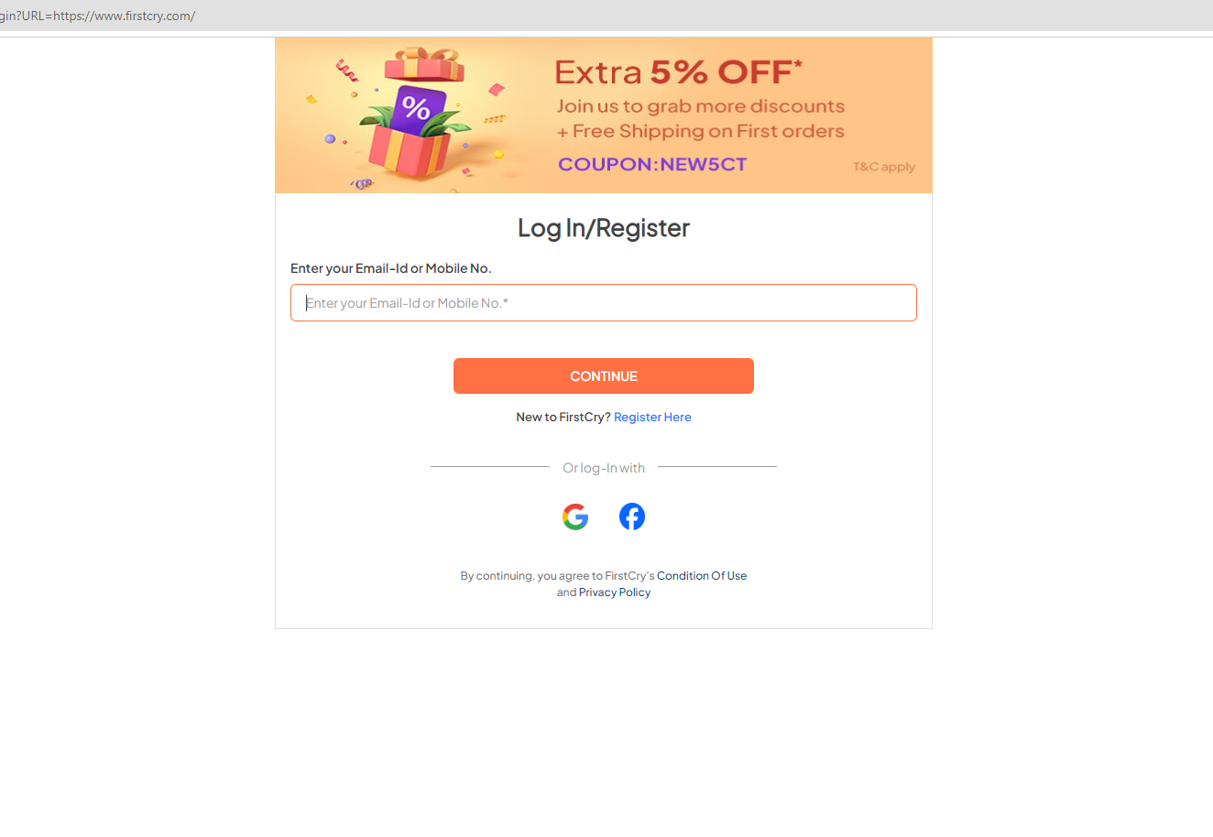
Login
To verify login with valid email I’d.
To verify login with invalid email I’d.
To verify login with valid Mobile Number.
To verify login with invalid Mobile Number.
To verify login with empty fields.

Slide 35
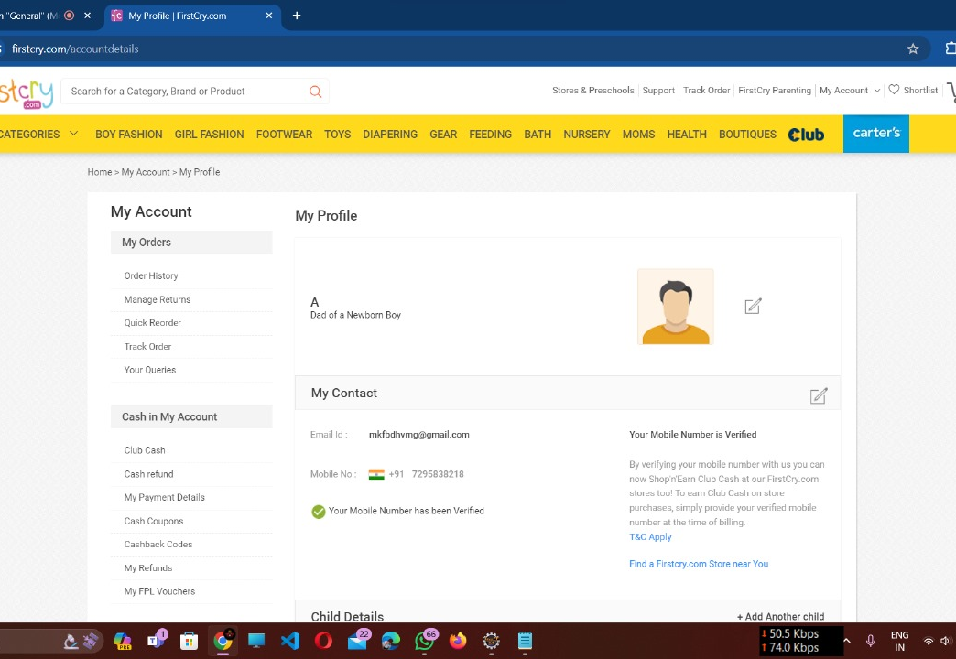
My Profile
User can go My Account.
User can update Profile Details.
User can enter valid Contact number.
User can add new Child.
User can delete a child.
User can add new address in their profile.
User can delete an existing address.
User can manage the subscription features.

Slide 36
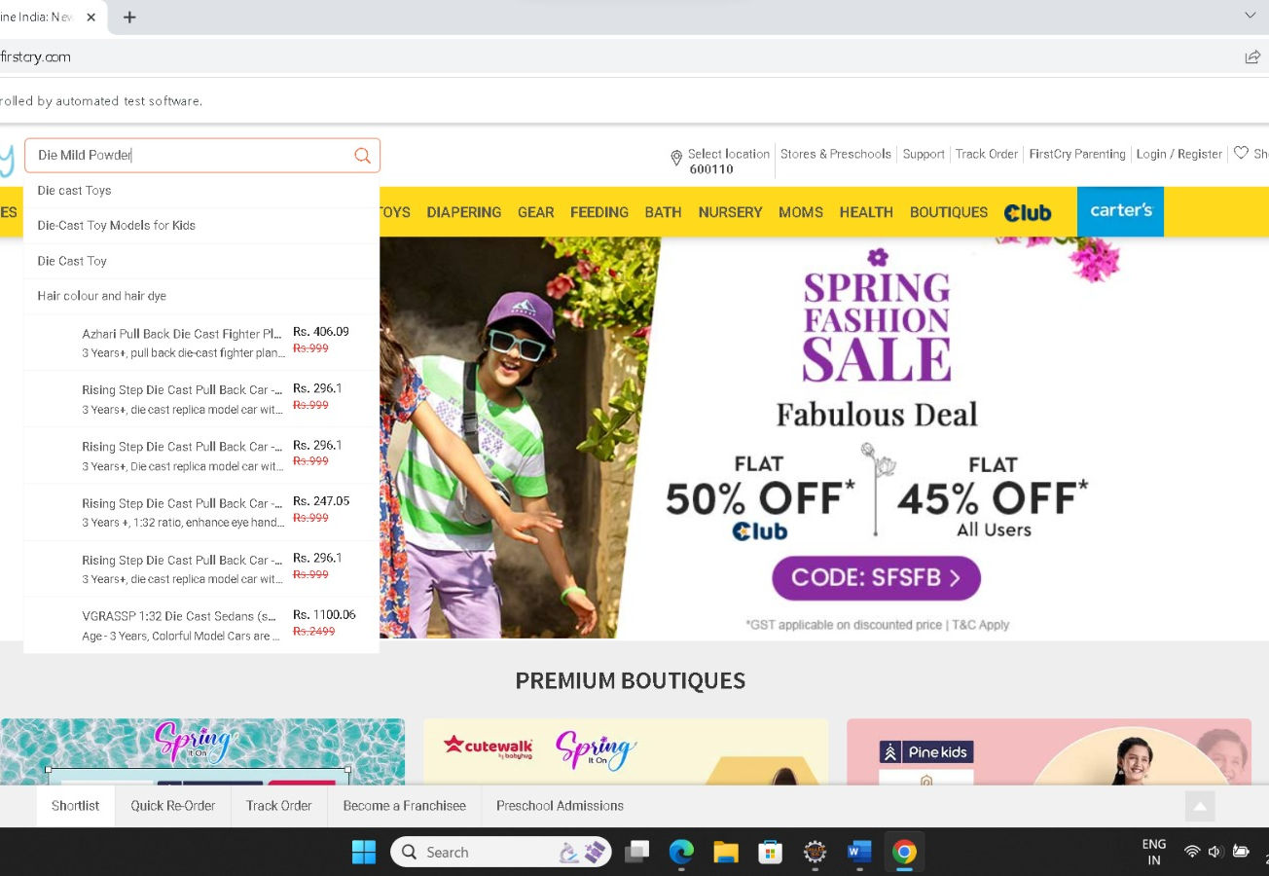
Search
Click search bar and enter text.
Verify the behavior of advance search by applying discount, brands, etc.
To verify when specific categories are selected and product is searched.
Verify the behavior when valid and invalid product names are entered in search bar.
Validate empty string search.

Slide 37
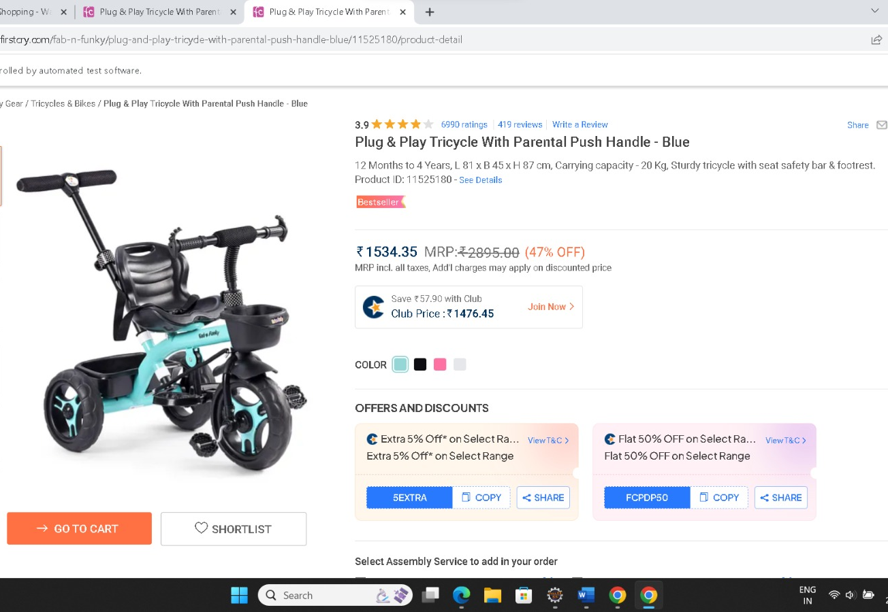
Add product to Cart:
Confirm AddToCart button is clickable or not.
Confirm whether all products have AddToCart button or not.
Add the third product from toys menu into the cart.
Check the checkbox is enabled for removing the product from cart

Slide 38
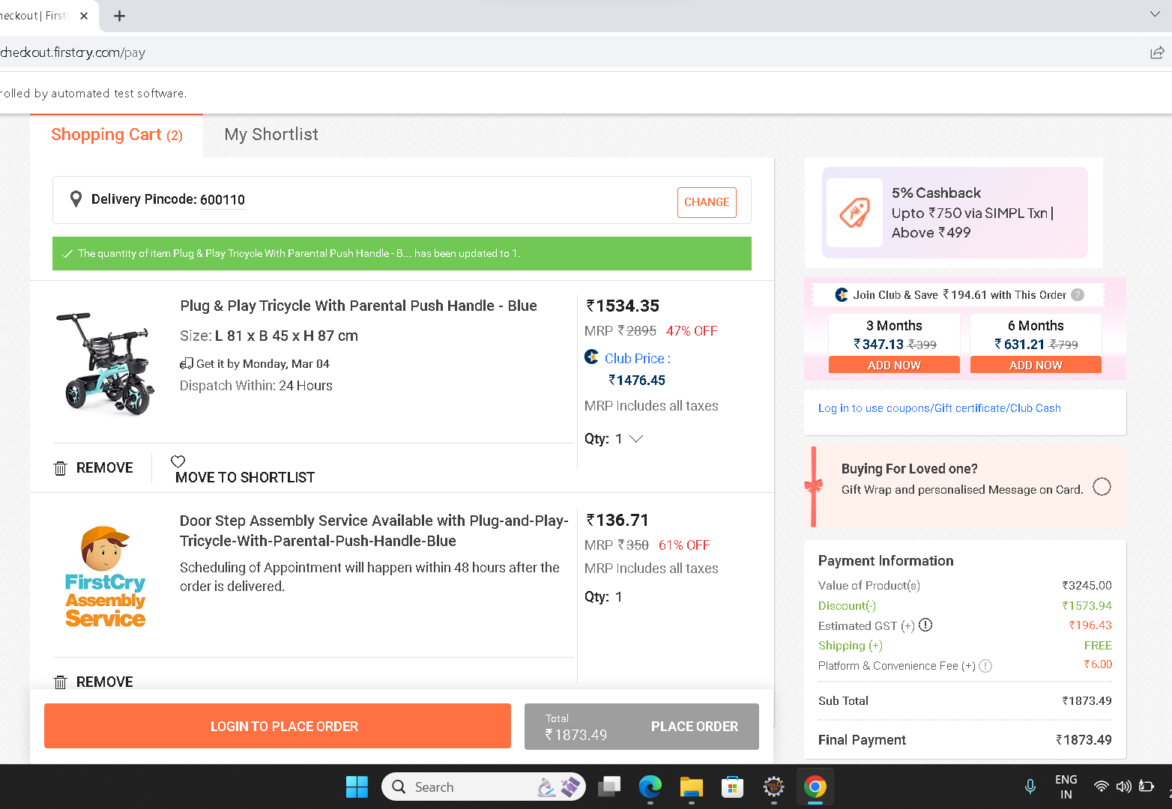
Cart:
Verify that when user clicks on add to cart, the product should be added to cart.
Verify that user should be able to continue shopping after adding items to cart.
Verify that item quantity should be increased if user adds same item in cart again.
Verify that total sum of products should be displayed to user.

Slide 39
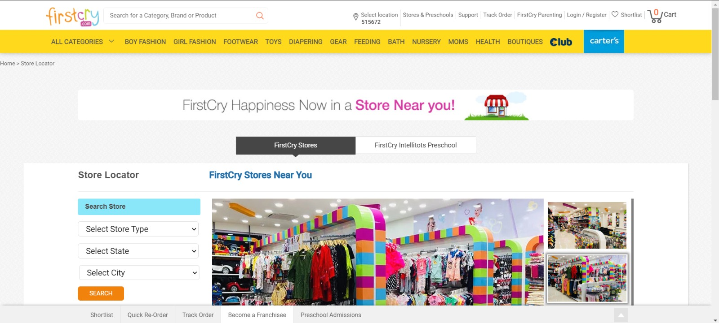
Store Locator:
Clicking on Stores & Pre Schools.
Clicking on Find Stores Option from Dropdown.
Selecting Fields from Dropdown.
Viewing Store Details with Blank Selections.
Viewing Store Details with Missing Fields.

Slide 40
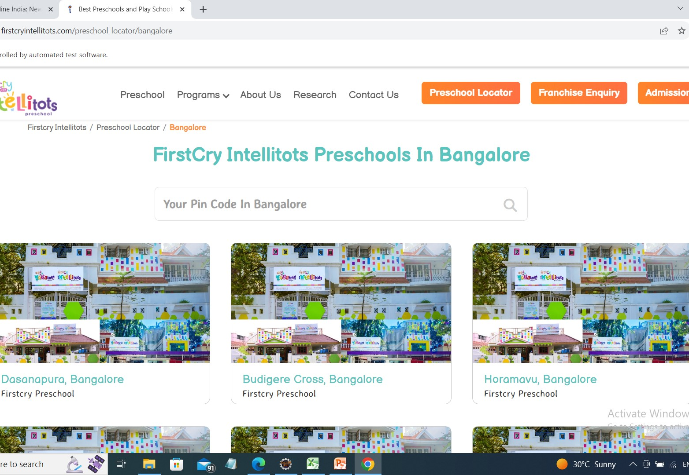
Preschool Locator:
User can click on Stores & Preschools for Launch and accessibility test.
User can click on find Preschools option from the Dropdown.
Enter a valid location in the search bar with valid details.
Finding Preschools without Pin code .
Finding Preschools with invalid details.

Slide 41
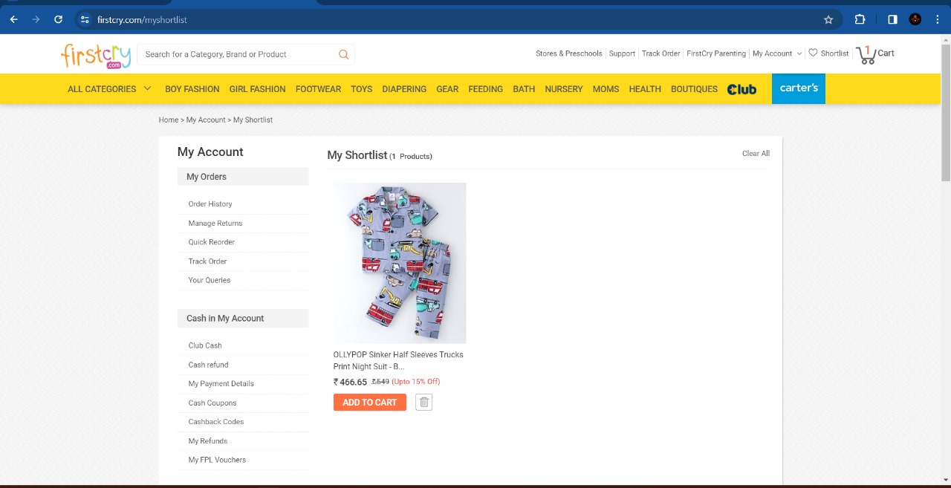
Shortlist:
User wants to add product to shortlist.
User wants to move product from shortlist to cart.
User wants to delete from shortlist.

Slide 42

SCREENSHOTS

Slide 43
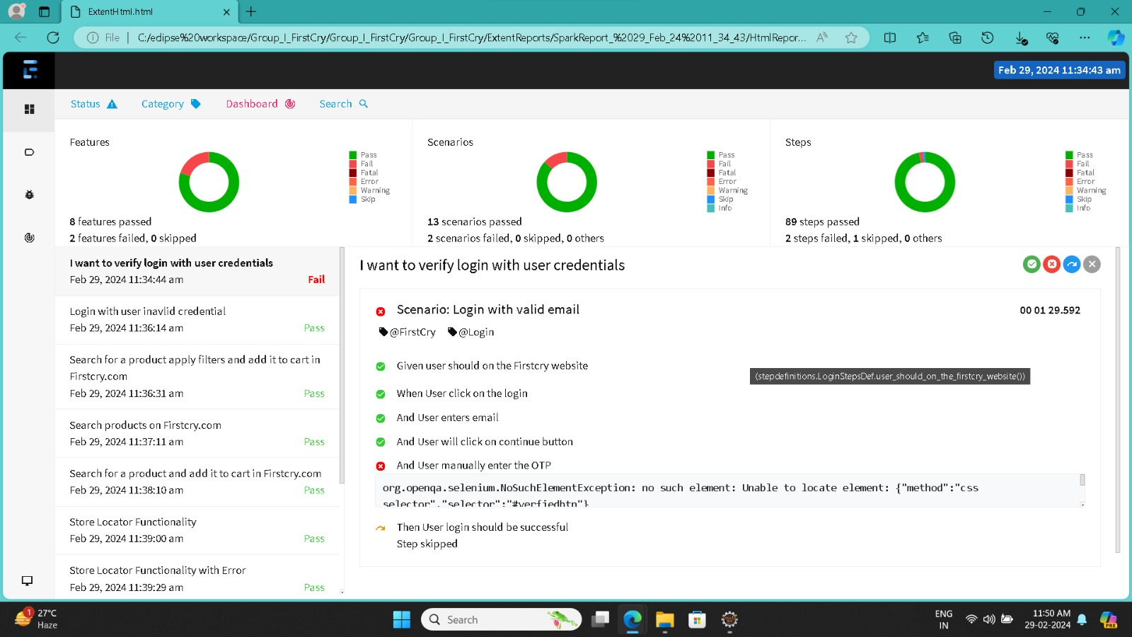

Slide 44
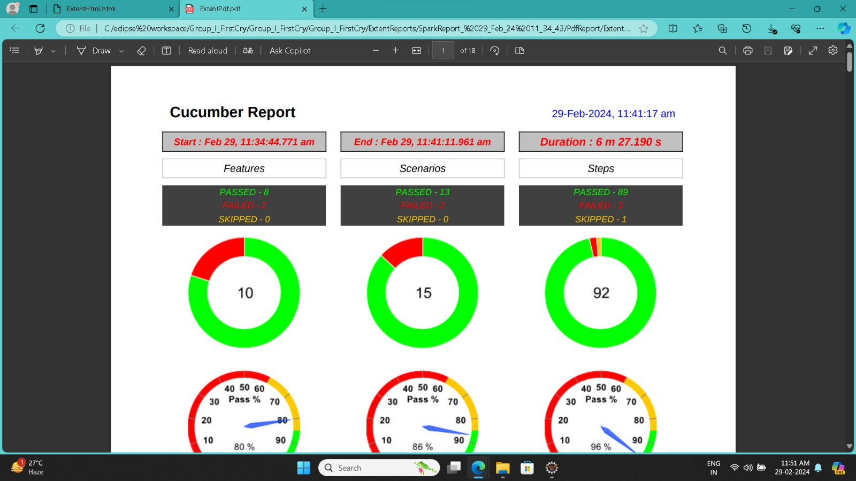

Slide 45
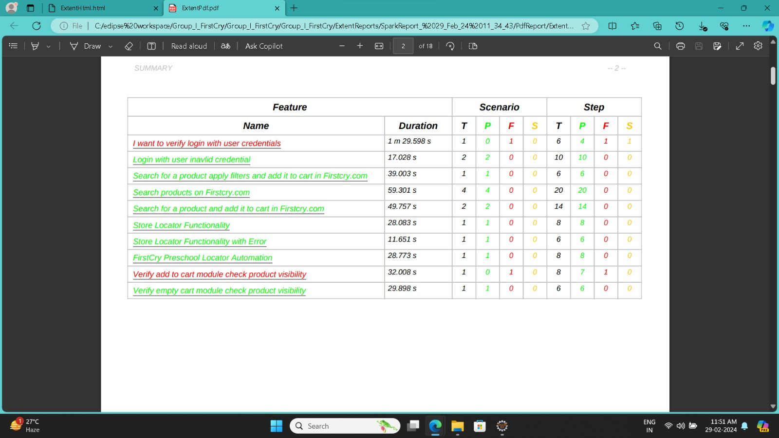

Slide 46
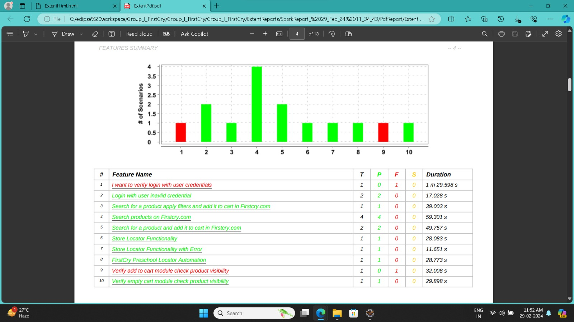

Slide 47
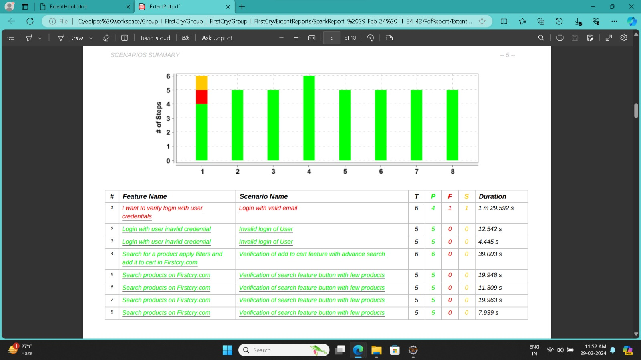

Slide 48
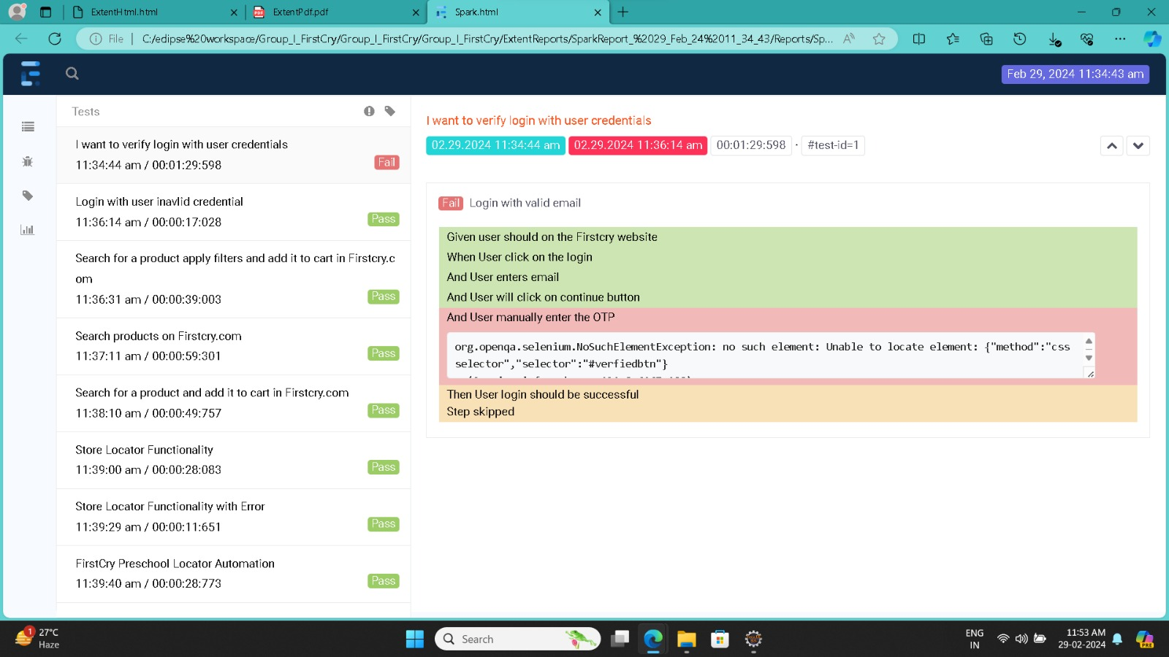

Slide 49
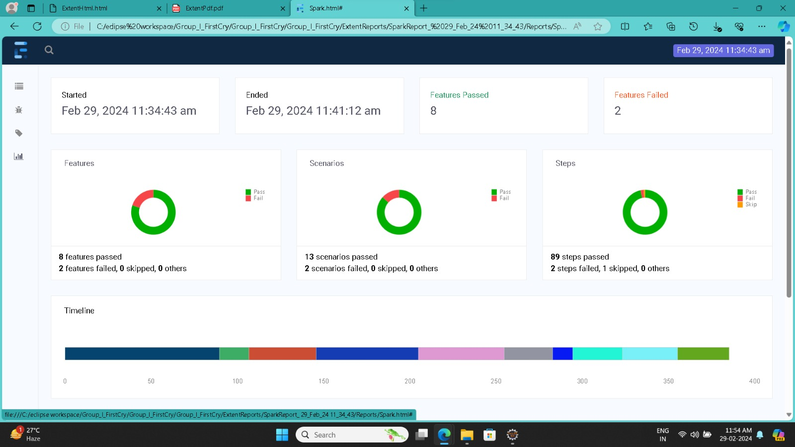

Slide 50
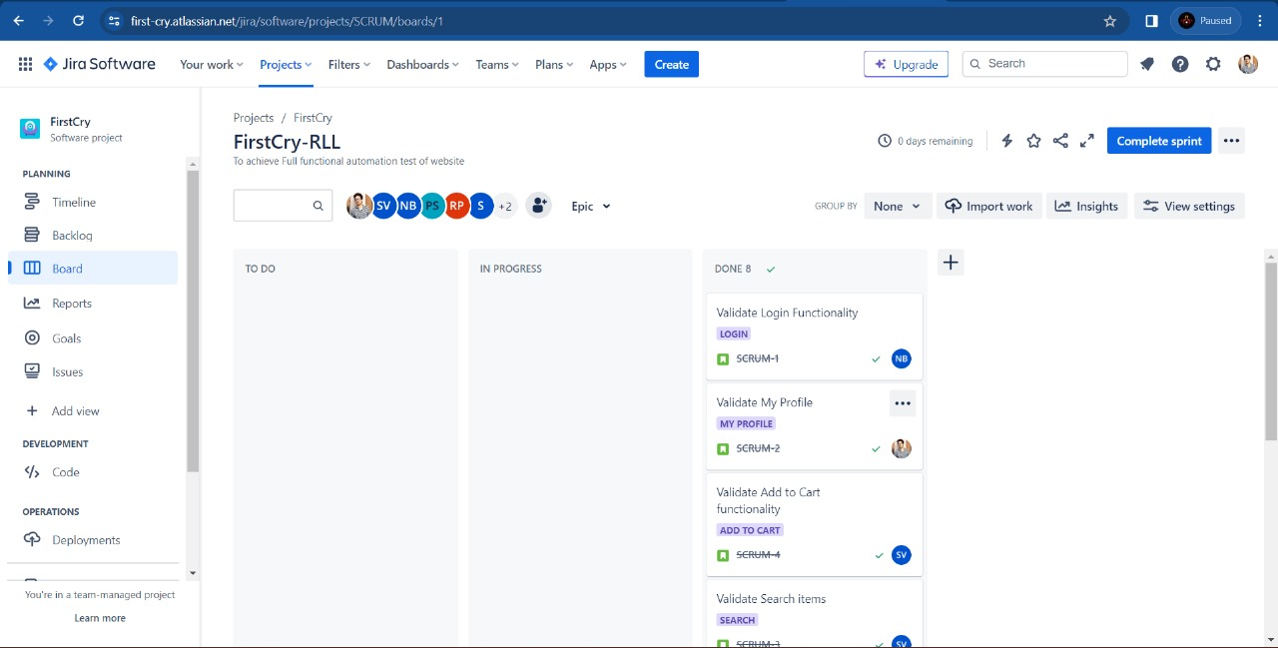

Slide 51
Conclusion
The project met the specified requirements and was running successfully in eclipse.
All the test scenarios are verified Including positive and negative cases
The project has successfully generated Extent reports and captured screenshots
JIRA was utilized for Test Management Lifecycle.
Here, we have merged all the test scenarios in one Git hub repository:

Slide 52







Thank you
Batch_01
Mphasis
FirsctCry

